Slide 1
Chapter 9: Memory and Development

Slide 2
Introduction
Memory connotations
  Memory covers many different types of systems/processes
  Episodic and semantic memory develop at different rates
    Suggests that these constitute separate systemes
Notes:
Memory connotations:
Memory covers a great many different kinds of systems and processes.
Some parallels exist among the development of memory systems in early life and changes in old age.
The differential growth of different systems: Episodic and semantic memory tells us that the systems are different.
Age-segregated situation: While in college, one spends much more time with people approximately the same age as with young children and older adults, albeit there are exceptions.

Slide 3
Memory in Children
Development of separate memory processes.
  Evidence suggest little or no autobiographical memory in infants/young children
Procedural learning:
  Acquiring complex motor tasks
  Much memory in infancy is procedural
Notes:
Development of separate memory processes:
Examining the differences in how separate memory processes develop and change.
It helps to learn about the development of memory in infants and young children.
There is some evidence to suggest that little to no representation of autobiographical events occurs at this point in a person’s life.
Procedural learning: The acquisition of complex motor tasks.

Slide 4
Memory in Infancy (1 of 3)
Infants lack motor control.
Absence of an obvious set of behaviors.
Lack verbal responses…
How to study memory???
Notes:
Satisfies Learning Objective 1: Define the changes that occur early in infancy with respect to different systems of memory.
Lack of motor control:
Human infants lack motor control.
This presents a problem for memory researchers, as researchers must be able to observe a behavior to document memory.
Absence of an obvious set of behaviors:
Verbal responses are also absent in human infants.
Memory researchers have to rely on clever innovations to study infant memory.

Slide 5
Memory in Infancy (2 of 3)
Visual recognition
  Habituation/Novelty studies
Nonnutritive sucking.
  Infants suck on pacifiers at a quicker rate around new stimuli
Notes:
Satisfies Learning Objective 1: Define the changes that occur early in infancy with respect to different systems of memory.
Visual recognition:
Infants look selectively at novel stimuli over familiar stimuli.
Novelty preference:
Bias to look at things that are new.
Researchers can tell when an infant remembers something, because the novelty preference will not be present.
Continuing novelty preference for old objects indicates that something is interfering with learning.
Newborns are equipped with a functioning auditory system that allows researchers to examine auditory recognition as well as visual recognition.
Studies prove that newborns can discriminate their mother’s voice from that of other women; auditory recognition begins before birth.
Nonnutritive sucking:
Infants suck a pacifier differentially in the presence of a novel stimulus compared to a familiar stimulus.
It can be monitored by sensitive electronic equipment that measure how fast or slow the infants are sucking.
A novel stimulus will usually elicit an increase in sucking.
Familiar stimuli will either not affect the rate of sucking or decrease it.
Conjugate reinforcement technique:
It is a useful technique to study memory in infants approximately age two months to about six months.
To test memory, researchers impose a retention interval of a few minutes or several weeks.
Babies as young as three months will remember the relation between kicking and reinforcement up to one week later.
Using the technique, researchers have demonstrated a spacing effect as well as “misinformation” effect.
Hartshorn and Rovee-Collier developed a parallel technique to work with older infants.

Slide 6
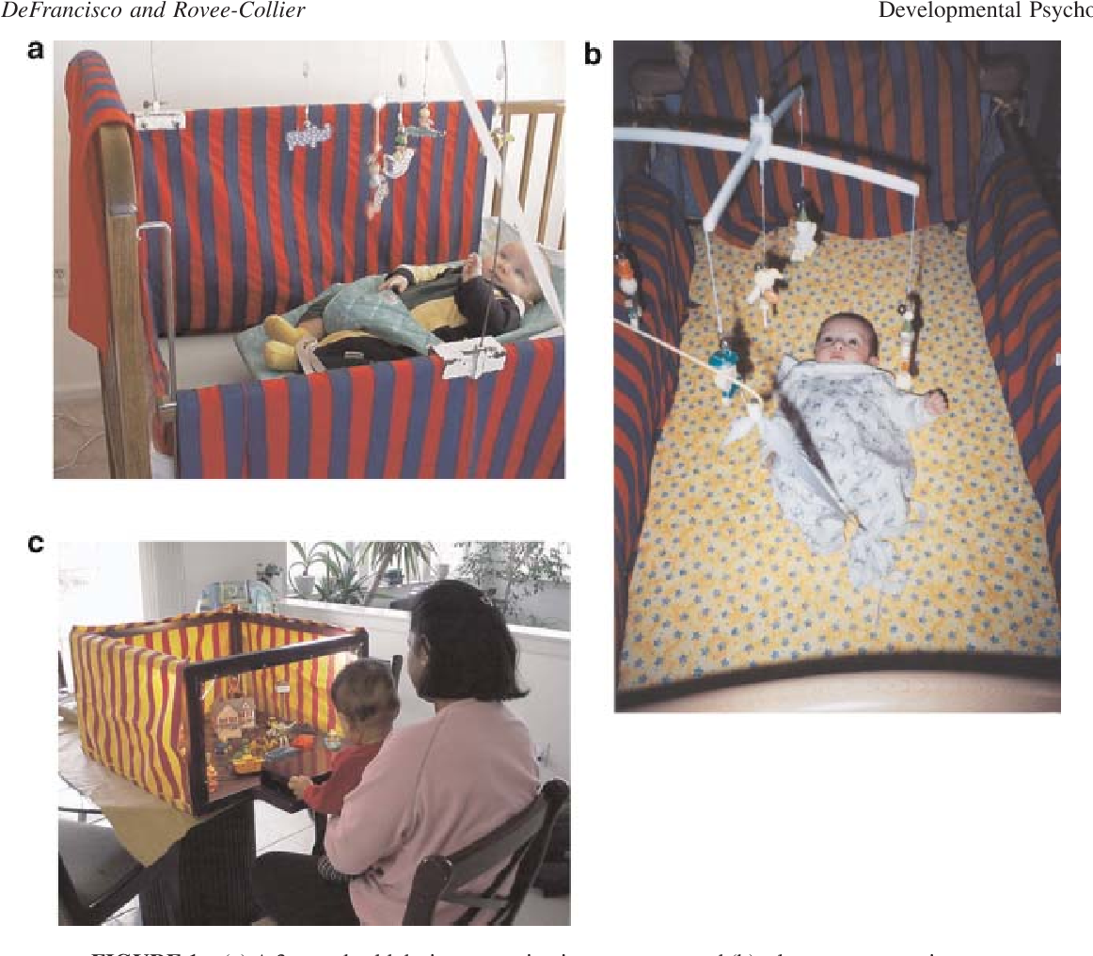
Rovee-Collier Experiments
Ribbon from a mobile is attached to 2- or 3-month-olds leg
Baby quickly learns that kicking leg == moving the mobile
Baby remembers this days and weeks later
Most babies forgot after several weeks, but remembered after being reminded

Slide 7
Memory in Infancy (3 of 3)
Imitation: Mimicking the actions of others
  More similar to recall than recognition
Memory for language in infancy.
  A massive amount of language-related information is learned by first birthday
Notes:
Satisfies Learning Objective 1: Define the changes that occur early in infancy with respect to different systems of memory.
Imitation:
Mimicking the actions of another.
Imitation requires learning and so it can be used as a marker of memory in infants.
It is more similar to recall than to recognition.
Imitation has allowed memory researchers to explore the origins of many of the memory systems that come to dominate cognition in older children and adults.
Memory for language in infancy:
Breaking the language code is one of the most monumental achievements of an infant.
A massive amount of language-related information is learned by a baby’s first birthday.
Infants familiarize themselves with the phonemes (sounds) of their native language very early.
Infants also learn the symbolic meanings of words by the end of the first year.

Slide 8
Memory in Early Childhood (1 of 6)
Advantages for memory researchers:
  Young children can both understand and produce speech
Challenges for memory researchers.
  Young children may not understand instructions that older children would
  No reading or writing
Notes:
Children at two years: Children, at this age, enter the world of language and can both understand and produce speech.
Advantages for memory researchers:
Experimenters can use verbal commands and children can produce verbal reports, allowing researchers to examine many more aspects of memory than during the first year of life.
Verbal abilities allow researchers to explore the origins of the declarative memory systems.
Challenges for memory researchers:
Children at this age may not understand instructions that older children or adults will understand.
Children younger than five years of age cannot use any written instructions or written responses.

Slide 9
Memory in Early Childhood (2 of 6)
Why Does Memory Improve During Early Childhood?
Memory efficiency view.
Memory strategies view.
Notes:
Memory efficiency view: Memory improves in young children because of increases in speed and efficiency in learning new information and storing it in long-term memory.
Memory strategies view: Memory improves in young children because of the development of conscious activities a child engages in to assist the remembering of information.

Slide 10
Memory in Early Childhood (3 of 6)
Memory Strategies View: Children use more effective strategies with age
Rote rehearsal vs. elaboration vs. imagery
Strategy use may develop as early as two years of age
Notes:
Memory strategies:
Reminding oneself of things that need to be remembered.
Rehearsing unlearned information.
Allocating cognitive resources.
Using retrieval strategies.
Development:
Memory strategies may develop as early as around two years of age.
This was empirically demonstrated by DeLoache et al.
Elaboration:
Connecting the new to-be-learned material to well-learned material, by looking for meaningful connections between the two.
Younger children do not spontaneously use elaboration.
Children also do not seem to use organizational strategies until third grade.
Power of imagery:
Imagery can aid the learning of new information, although young children do not spontaneously use imagery to boost their memory.
However, when trained to do so, children can benefit from the use of imagery, as demonstrated by de Graaff et al.

Slide 11
Memory in Early Childhood (4 of 6)
Memory Efficiency View: Memory systems become more effective w/ development
Memory capacity: The amount of information that can be stored in working memory
Working memory efficiency: Better able to screen out irrelevant information
Long-term memory efficiency: Better ability to retain information long-term
Notes:
Memory capacity:
The amount of information that can be stored in working memory.
Memory capacity increases during early childhood.
Improved working memory capacity means that older children have a larger buffer in which to store information than do younger children.
Working memory efficiency:
Related to the ability to screen out irrelevant information.
Older children are better able than younger children to inhibit irrelevant information in working memory.
Older children were better at directed forgetting than the younger participants.
Children could use directed forgetting to inhibit items that they were not supposed to remember.
Children were better able to inhibit emotional items than neutral items.
Long-term memory efficiency:
Improves in early childhood.
Studies prove that older children will retain more information than younger children, given an equal amount of study time.
Because recognition tests are less sensitive to the use of memory strategies than recall tests, improvements in long-term memory efficiency in older children are because they use better strategies to encode information.

Slide 12
Memory in Early Childhood (5 of 6)
Episodic Memory
Childhood amnesia.
Tessler and Nelson (1994): Social interaction facilitated children’s memory
Notes:
Childhood amnesia:
Adults remember no events from the first three years of life (by and large) and few from the next two years.
Some researchers believe that episodic memory does not develop until a child is around three years of age.
However, young children have something very similar or identical to episodic memory at quite young ages.
Important study by Tessler and Nelson:
The researchers examined the memory of three-and-a-half-year-old children who visited a museum.
Seven days later, the children remembered the event in some detail, clearly demonstrating episodic remembering, although some interesting features distinguished the children’s memory reports from memory reports of adults.
Evidence from other research:
Young children can retain autobiographical events over intervals of years, as empirically demonstrated by Sutcliffe Cleveland and Reese.
Older children were able to remember some (about 50%) of the original events from their childhood in an accurate manner.

Slide 13
Memory in Early Childhood (6 of 6)
Role of parents in childhood memory
  Parents often dictate the kinds of recollections that children have
  More open and elaborative conversation = more childhood remembering
Notes:
Memory conversations: Talk between a parent and a child concerning past events. Discussions we have with others about the past.
Role of parents:
Most research suggests that parents often dictate the kinds of recollections that children have and direct recall in particular directions.
However, parenting styles may differ while discussing past events with young children.
The more open-ended and elaborative the conversation between parent and child, the more the child will remember later.
Evidence from research:
Parents’ style affects the recall of young children in both formal and informal settings.
This fact is borne out in research by Tessler and Nelson, and corroborated by Peterson et al.
Generally speaking, elaborative discussions lead to children with better autobiographical memory.
Cultural variations:
Cultures differ in their emphasis on the role of autobiographical memory.
Parent–child interactions in the United States are much more likely to be discussions of past events than those in China.
This may be the reason why US adults remember events from their early childhood better than Chinese adults.

Slide 14
Memory in Older Children
Working memory begins to approximate adults
Older children more likely to elaborate on information
Paradoxical effects:
  Because older children use more meaning based encoding, they are more susceptible to memory illusions than younger children
  Example: DRM memory illusion
Notes:
Satisfies Learning Objective 2: Assess changes in memory and metamemory in older children.
Changes in working and episodic memories:
The transition to middle childhood begins around the age of 7 and ends around the age of 14 or 15, when the mind becomes adult-like.
Changes in memory focus on the integration of meaning into episodic memory and the emergence of adult features in working memory.
Most children, by the age of 9, can maintain six digits in the phonological loop.
This improvement is both a function of improved strategic regulation of memory and improved fluency of memory processing.
A key contributor to the improvement of episodic memory is that older children elaborate on the to-be-learned information or tie new events to already existing knowledge structures.
Paradoxical effect of the transition:
Several studies show that because older children are now encoding for meaning, they are more susceptible to memory illusions than younger children.
The older the children were, the better they did on the recall test.
Younger children were more accurate and less likely to include a false memory in their memory report.
Older children recalled more correct information but recalled more critical intrusions than did younger children.
Baugerud et al. found more false memories in the DRM in older children than younger children.
Age-inverted effects:
Many studies show age-inverted effects with respect to false memory.
This is supported in studies by Fazio and Marsh, Ceci et al. who found that older children were more likely to have story-based false memories.
The data mean that older children have more meaning-based memory errors.
Strange et al., in their study of autobiographical memory, proved that the occurrence of more or fewer false memories in older children is a function of their increased focus on meaning.
This pattern was confirmed by a study by Otgaar et al.
Data from neuroimaging: The neural basis for the change from literal-based memory to meaning-based memory in children was found in a study by Chiu et al.

Slide 15
Metamemory in Children
Theory of Mind: children’s awareness of their own and other people’s mental processes
Tested in young children using “false belief task”
Notes:
Satisfies Learning Objective 2: Assess changes in memory and metamemory in older children.
Metamemory: Our knowledge and awareness of our own memory processes.
According to Flavell et al., metacognition was the basis of improvement in memory during early childhood.
However, metacognition develops earlier than was originally thought.
Theory of mind and false-belief test:
Theory of mind: The awareness that other individuals have separate states of awareness different from that of our own.
Children are not fully equipped with theory of mind until about the age of four.
False-belief test: A child learns something that another person does not have the opportunity to learn. The child must decide whether the other person knows what he or she knows.
The false-belief test has been experimentally verified in empirical research, for example, in the studies by Wimmer and Perner.
The theory of mind refers to our knowledge of other minds.
Metacognition:
Our understanding of our own minds.
Develops in a rudimentary form around the same time as theory of mind.
Metacognitive experiences can be channeled into explicit judgments, such as judgments of learning by the time most children are in second grade.
Judgments of learning are predictions that people make as to the likelihood that they will remember an item when asked to do so on a later test.
Schneider et al. examined the ability of kindergartners, second graders, and fourth graders to make judgments of learning.
Similar studies have been undertaken by Koriat and Shitzer-Reichert.
Metacognitive control is the ability to use metacognitive knowledge or experience to influence learning behaviors.

Slide 16
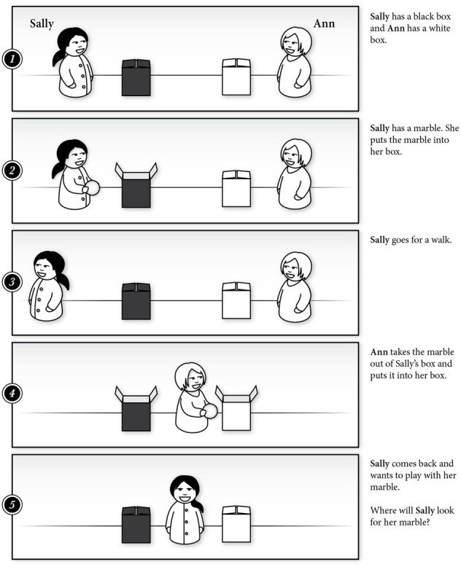
Assessed by examining children’s abilities to understand people can hold different beliefs about an object/ event
False Belief Task: 3-year-olds show a pattern of false belief errors that are robust across procedures and cultures
Notes:
Learning Objective: 7-3: Summarize changes in attention, memory, and thinking during childhood.
c. Theory of Mind
i. A child who believes he is having hot oatmeal for breakfast will be surprised upon receiving cold spaghetti
ii. Assessed by examining children’s abilities to understand people can hold different beliefs about an object/ event
iii. False Belief Task
1. Young children do not understand people can hold different beliefs and some may be incorrect
2. Three-year-olds show a pattern of false belief errors that are robust across procedures and cultures.
iv. Cognitive Skills and False-Belief Understanding
1. Advanced cognition is needed for children to learn abstract concepts such as belief
2. Performance on false belief tasks is related to language development

Slide 17
Memory in Older Adults
The importance of preserved memory function.
  Sense of identity
  Worry about memory declines in old age
Individual differences in memory loss!
Memory systems decline at different rates!
Notes:
Satisfies Learning Objective 3: Appraise the differential patterns of improvement and decline in older adult memory.
The importance of preserved memory function:
Preserved memory function is seen as vital to maintaining health and competence as we get older.
Memory provides us with our sense of identity.
It also allows us to keep track of the things that are vital to our survival.
Memory provides a way of avoiding deception.
Individual differences:
An individual’s memory abilities should not be judged by his or her age as distributions overlap, and any individual older adult may outperform an individual younger adult.
Cognitive psychology makes generalizations about trends and patterns while acknowledging these individual differences.
Many flavors of memory:
Multiple memory systems exist.
There are many processes involved in producing and retrieving memories.
Older adults may have declines in some aspects of memory, while they may have no declines or may even have advantages in others.

Slide 18


Slide 19
Theories of Aging and Memory (1 of 3)
Declining Processing Speed
With adequate study time, older adults approximate younger adults
Age-related declines in reaction time (RTs)
Notes:
Satisfies Learning Objective 3: Appraise the differential patterns of improvement and decline in older adult memory.
Processing speed:
Age-related declines are caused because older people’s cognitive processing does not work as fast as that of younger adults.
Learning new information and retrieving stored information take longer.
The processing view does not predict deficits in memory performance that is untimed and does not require recall.
Memory as a physical skills:
While younger adults have quicker reflexes and stronger muscles, one loses quickness, and it takes longer to build muscle as one grows older.
Similarly, cognitive processes also slow down.
However, when older adults have ample time to study or process information, their performance may be no weaker than those of younger adults.
Age-related declines:
Studies that measure reaction time show age-related declines.
This is empirically proved by Salthouse in hist studies.
Predictive across a range of situations: The processing-speed theory is useful as it is predictive across a range of situations.

Slide 20
Theories of Aging and Memory (2 of 3)
Inhibition Theory: The ability to block out irrelevant information decreases with age
Memory declines result from poor attentional processes
Notes:
Satisfies Learning Objective 3: Appraise the differential patterns of improvement and decline in older adult memory.
Inhibition theory:
The ability to block out irrelevant stimulation decreases with age, so the memory declines seen in old age are a consequence of poor attentional processes.
Inhibition also means the ability to suppress retrieval of irrelevant information.
Directed forgetting:
The inhibition in memory that occurs when people are asked to forget some information but not other information.
Younger adults are possibly better at directed forgetting than are older adults.
Ironically, this means that older adults have better recall for the to-be-forgotten items than do the younger adults.
Empirical studies:
Darowski et al. found that older adults were more affected by irrelevant stimuli than were younger adults.
Colombel et al. classified older adults by their inhibition ability in order to see how such abilities affected both correct recall and false memory.
Findings from their study supports the view that inhibition failure may contribute to reduced memory in older adults.

Slide 21
Theories of Aging and Memory (3 of 3)
Decline in the Strategic Use of Memory
Older adults are less likely to use appropriate memory strategies due to deficits in working memory
Evidence: Older adults use less chunking when completing study tasks
Age-related memory declines: Likely a combination of multiple factors (processing, inhibition, and strategy use)
Notes:
Satisfies Learning Objective 3: Appraise the differential patterns of improvement and decline in older adult memory.
The theory:
The theory argues that declines in memory are a function of a declining use of appropriate memory strategies.
Older adults are less likely to explicitly use strategies that will help their encoding and retrieval.
The theory is based upon the claim that older adults have control deficits with respect to working memory that might interfere with strategy use.
Craik et al. argued that older adults engage in less self-initiated strategies.
Naveh-Benjamin et al. also demonstrated how older adults use less chunking than younger adults in a working memory task.
Arguments against the theory:
Hertzog believes that preserved metamemory abilities allow older adults to maintain high functioning, although they may decreased metamemory in some domains.
Sacher et al. concede that memory performance does affect feeling-of-knowing accuracy, although variations in feeling of knowing did not predict memory performance in older adults.
Castel et al. also added that older people direct their cognitive processes in more value-directed ways.
Age-related memory declines: They are likely caused by a combination of slower processing speed and reduced ability to inhibit irrelevant stimuli.

Slide 22
Age-Related Changes in Working Memory (1 of 2)
Short-term memory system.
Composed of three major systems.
  Phonological loop, visuospatial sketchpad, central executive
Central-executive deficits in older adults.
Notes:
Satisfies Learning Objective 3: Appraise the differential patterns of improvement and decline in older adult memory.
Short-term memory system:
Working memory is the short-term memory system that maintains information for conscious introspection over relatively short time intervals (up to 15 seconds).
Many researchers have argued that deficits in working memory in older adults are also responsible for the deficits seen in long-term memory.
Composed of three major systems:
The phonological loop maintains information about auditory stimuli.
The visuospatial sketchpad maintains information about visual stimuli.
The central executive allocates attentional resources to the appropriate system in case of increased task difficulty or when simultaneous processing if required.
The central executive system is the most negatively affected by age.
Central-executive deficits in older adults:
Göthe et al. compared younger and older adults on two tasks, a visuomotor task and a simple numerical task.
The researchers concluded that the results reflect differences in executive control on working memory tasks.
The findings have implications for dual tasking in everyday life.
The findings indicate that older adults might be even more at risk when trying to talk and drive at the same time.

Slide 23
Age-Related Changes in Working Memory (2 of 2)
Central-executive deficits in older adults.
  Older adults show worse performance when multi-tasking or task-switching
Notes:
Satisfies Learning Objective 3: Appraise the differential patterns of improvement and decline in older adult memory.
Short-term memory system:
Working memory is the short-term memory system that maintains information for conscious introspection over relatively short time intervals (up to 15 seconds).
Many researchers have argued that deficits in working memory in older adults are also responsible for the deficits seen in long-term memory.
Composed of three major systems:
The phonological loop maintains information about auditory stimuli.
The visuospatial sketchpad maintains information about visual stimuli.
The central executive allocates attentional resources to the appropriate system in case of increased task difficulty or when simultaneous processing if required.
The central executive system is the most negatively affected by age.
Central-executive deficits in older adults:
Göthe et al. compared younger and older adults on two tasks, a visuomotor task and a simple numerical task.
The researchers concluded that the results reflect differences in executive control on working memory tasks.
The findings have implications for dual tasking in everyday life.
The findings indicate that older adults might be even more at risk when trying to talk and drive at the same time.

Slide 24
Semantic Memory
Memory system: World knowledge
Most research suggests that semantic memory is preserved through age
Older adults are often better at encoding semantic information vs. younger adults
Notes:
Satisfies Learning Objective 4: Describe the research on memory and metamemory in older adults.
Semantic memory: The neurocognitive memory system that encodes, stores, and retrieves information concerning knowledge of the world.
Effect of aging:
Most studies point to the preserved nature of representation of information in semantic memory.
Older adults are often better able to encode information into semantic memory than younger adults.
Studies by Metcalfe et al.: In his paper, “On Teaching Old Dogs New Tricks,” he found that older adults were better able to correct errors after feedback on a semantic memory task than younger adults.
Studies by Carmichael and Gutchess:
The researchers examined the ability of younger and older adults to avoid errors in semantic memory retrieval.
Their study demonstrated that older adults are better able to use warnings to improve their semantic memory.

Slide 25
Episodic Memory (1 of 3)
Memory system: Personal experiences.
Evidence from research.
Declines in older adults
Preserved semantic memory skills might be helpful for episodic memory
Notes:
Satisfies Learning Objective 4: Describe the research on memory and metamemory in older adults.
Episodic memory: The neurocognitive memory system that encodes, stores, and retrieves memories of our personal individual experiences.
Evidence from research:
Episodic memory declines can occur in healthy older adults, both in encoding and retrieval.
Mohanty et al. demonstrated that preserved semantic memory skills could be used to improve episodic memory in older adults.

Slide 26
Episodic Memory (2 of 3)
Recall Versus Recognition in Episodic Memory
Recall is more impaired by age than recognition.
Why?
Recollection is based on familiarity, recall requires retrieval of information
Notes:
Satisfies Learning Objective 4: Describe the research on memory and metamemory in older adults.
Recall and recognition, and aging:
Recall is the ability to produce the correct answer by generating that answer from retrieval.
Recognition requires one to match a presented stimulus to one’s memory of the original.
Recognition is considered the easier test, as it can be done on the basis of familiarity, which seems to be unaffected by aging.
Recollection is impaired by aging.
Evidence from research: The ability to recall information declines with age but that recognition performance remains relatively stable.
Performance on recognition tests:
Older adults show relatively equal performance on recognition tests as younger adults.
This fact is demonstrated in a study by Rhodes et al.
Performance on recall tests:
In this case, older adults typically show deficits relative to younger adults.
This fact is experimentally verified in studies by Dunlosky and Hertzog, and Koen and Yonelinas.

Slide 27
Episodic Memory (3 of 3)
Memory Accuracy in Episodic Memory
Older and younger adults often similar on simple recall tests
Similar accuracy, but younger adults remember more details
Who makes for a better eyewitness?
Notes:
Satisfies Learning Objective 4: Describe the research on memory and metamemory in older adults.
Performance on recall tests: In simple free recall and cued recall tests, older adults and younger adults exhibit the same level of accuracy.
Memory accuracy across age:
Memory accuracy is equivalent across age.
This was demonstrated by Hargis and Castel.
Implications for eyewitness testimony:
Younger adults make better witnesses for the initial phases of investigation because they remember more details.
In a courtroom, an older witness is can remember as accurately as a younger witness.
This was empirically tested by Dahl et al.

Slide 28
Metamemory in Older Adults (1 of 2)
Older adults believe that their memory is not as good as younger people
Older adults tend to be pessimists about their memory, even though many memory systems remain intact for healthy older adults
Notes:
Satisfies Learning Objective 4: Describe the research on memory and metamemory in older adults.
Beliefs about our memory systems:
It is important to assess memory beliefs among older adults and then determine to what extent these beliefs correlate with actual memory performance.
It is also important to consider how the beliefs themselves affect memory.
Research by Dunlosky and Metcalfe:
Older adults believe that:
Their memories are not as good as those of younger people.
Their memories are not as good as they used to be when they were younger.
They have less control over the efficiency of their memory than they did when they were younger.
Based on these, the researchers concluded that older adults tend to be pessimists, believing in memory decline.
Fortunately, however, many areas of memory, such as semantic and lexical memory, remain intact in healthy older adults.
Self-perceptions of memory abilities old adults:
Older adults make decisions based on their self-perception of their own memory abilities.
They may be less likely to engage in strategic memory behaviors, believing their memory is impaired.
Monitoring of learning: Metamemory judgments can be made to assess whether we have learned a particular item or whether we think we are going to retrieve information.

Slide 29
Metamemory in Older Adults (2 of 2)
Judgment of Learning studies
Older adults provide JOLs that are just as accurate as younger adults
Notes:
Satisfies Learning Objective 4: Describe the research on memory and metamemory in older adults.
Judgments of learning:
Judgments made during study of whether the item has been learned.
High judgments of learning indicate a prediction that the item will be remembered.
Low judgments of learning indicate a prediction that the item will not be remembered.
Importance:
In younger adults, they have been shown to be highly accurate in some circumstances but less accurate in others.
They are highly predictive of study behavior.
Relevance for older adults:
Judgments of learning can be used to ask whether older adults feel that they are less likely to remember each item.
They can also be used to determine if older adults are more, equal, or less accurate in their judgments relative to younger adults.
Empirical evidence:
Hertzog et al. looked at the accuracy of the judgments at predicting recall.
They found that older adults showed just as good accuracy as the younger adults.
Accuracy in older adults benefited from a delay between study and test.
These findings have been confirmed by a number of other studies as well.

Slide 30
Maintaining Memory Ability in Older Adults
Memory decline is inevitable
  Response times begin to slow in our 30’s
  Age-related diseases can increase slowdowns in older age
Buffers against memory decline
  Education
  Physical Fitness
Use-it-or-lose-it hypothesis:
  Snowden’s Nun study (2006)
Notes:
Satisfies Learning Objective 3: Appraise the differential patterns of improvement and decline in older adult memory.
The inevitability of memory decline:
All of us do lose a bit in terms of the speed of our responses as we get older, starting in our 30s.
Age-related diseases that affect memory may occur regardless of the behaviors that older adults engage in to prevent them, although certain behaviors tend to alleviate them.
Buffers against memory decline:
More educated people maintain cognitive skills longer and later into older adulthood, as verified by Shimamura et al. in their study of college professors.
More educated adults are also less likely to experience some forms of abnormal aging, such as Alzheimer’s disease.
Physical fitness is another buffer with older adults who exercise routinely showing greater cognitive abilities.
Use-it-or-lose-it hypothesis:
Older adults who engage in complex mental activity on a regular basis are more likely to preserve function, whereas those who do not are more likely to suffer declines.
Empirical evidence in support of this theory has been provided by Snowdon, in a study of nuns who spent more time engaged in mentally demanding exercises.
These nuns maintained cognitive function to an older age and were also less likely to develop Alzheimer’s disease.
Lineweaver et al. (2019) also showed how many older adults specifically choose memory strategies because they believe in this hypothesis.
Attentional control:
Binder et al. focused on improving memory and cognitive performance by working on attentional control.
Based on their findings, it was concluded that focusing on cognitive weaknesses can lead to improvements in performance.

